Slide 1
Mini Research about Business Intelligence & Data Warehouse Key Concepts

Slide 2
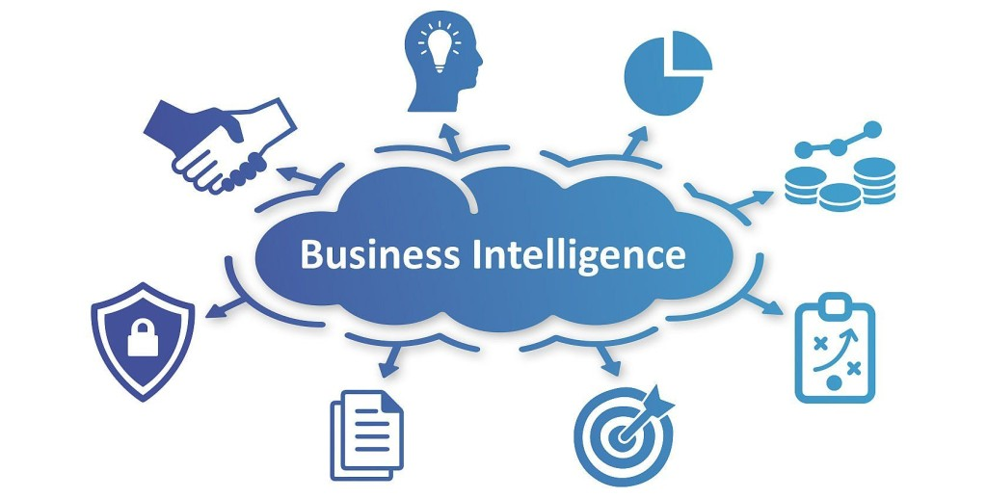
What is business intelligence as a concept?
Business intelligence (BI) is a way for organizations to collect, manage, and look at data to find useful information that helps them make better decisions. BI helps businesses look at data from the past and present, including real-time data, from different sources like their own data, third-party data, and even social media. By studying this data, businesses can see trends, solve problems, find new opportunities, and make smarter decisions (IBM, 2023, para. 1).
Business Intelligence helps businesses understand patterns in the data. This gives them helpful information that can guide decisions. It helps users see how well the business is doing and figure out what affects its performance (CIO.com, 2023, para. 2).
Figure 1
Business Intelligence
Note. From Bigdata Analytics News, 2017, para. 1.
BI also looks at data in ways that are easy to understand, usually showing it as charts, graphs, and dashboards. This helps businesses make sense of complex data. BI helps companies make better decisions, improve efficiency, and stay competitive by giving them timely insights into things like customer behavior and changes in the market (Oracle, 2023, para. 1; Google Cloud, 2023, para. 1).

Slide 3
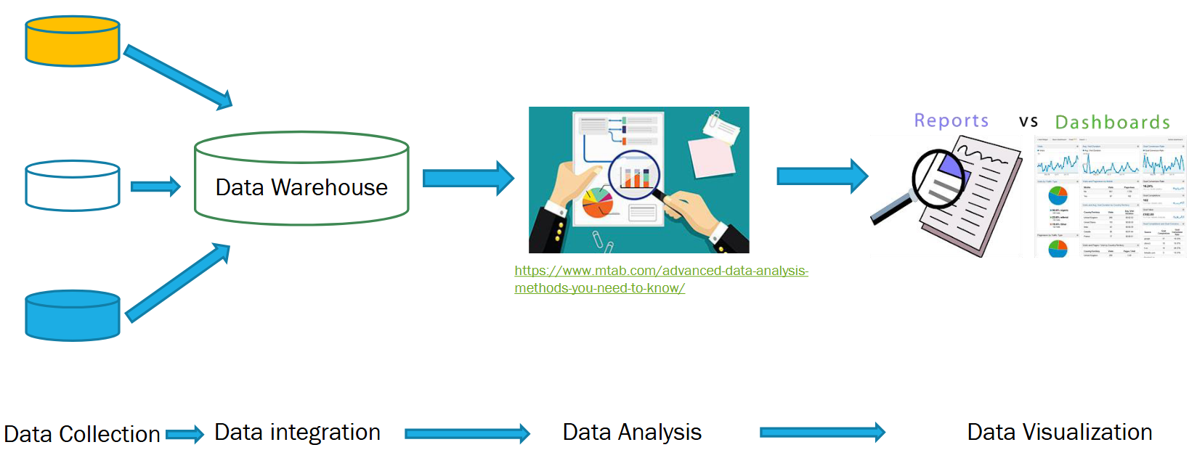
Business Intelligence helps organizations gather, study, and understand data to make better decisions and solve problems (IBM, 2023, para. 4; CIO.com, 2023, para. 2).
Figure 2
Business Intelligence Working
Note. From mTab, n.d., para. 1.
Tools Used in Business Intelligence:
Integration
Commercially available integration tools
Online Analytical Processing (OLAP)
Custom integration tools, often leading to the creation of a Data Warehouse
Reporting and Analysis:
Spreadsheets
Commercially available BI tools
Custom reporting and analysis tools

Slide 4
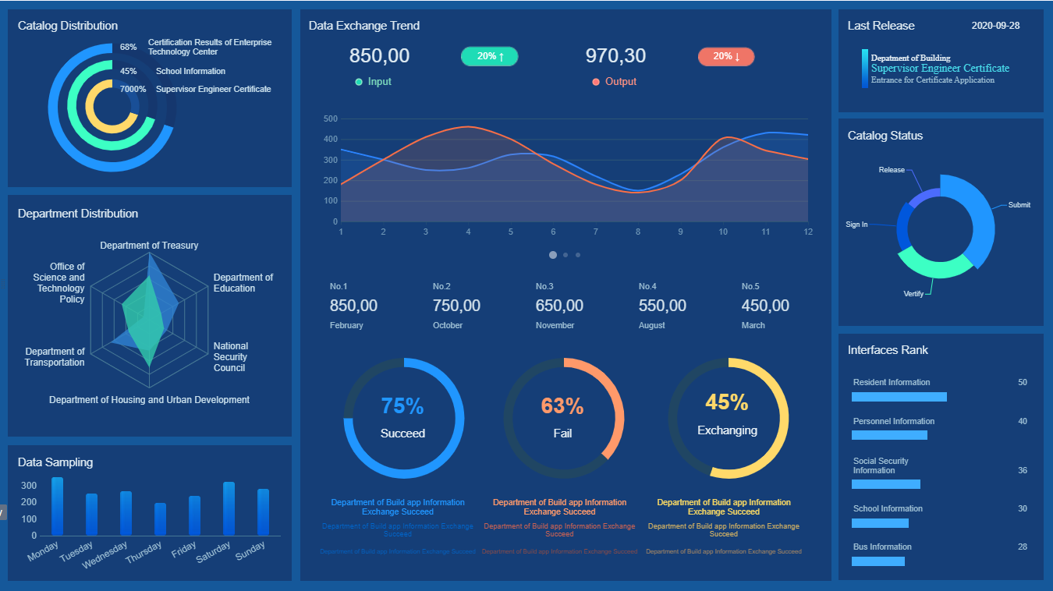
What is the definition of a business intelligence system?
A Business Intelligence (BI) System is a comprehensive framework designed to collect, process, and analyze data, turning it into meaningful and actionable insights for businesses. It integrates a variety of tools, applications, and methods to gather data from both internal systems and external sources (Warehouse Logistics, n.d., para. 1).
This data is often stored in a data warehouse, which provides a centralized and uniform platform for analysis while avoiding any slowdown in the performance of operational systems due to data-intensive evaluations (Warehouse Logistics, n.d., para. 1).
The BI system then processes and organizes this data, presenting it visually in the form of reports and dashboards. This visual presentation simplifies the data for decision-makers, enabling them to extract critical information and make informed decisions more efficiently (Warehouse Logistics, n.d., para. 2).
Figure 3
Business Intelligence System – Dashboard Reporting
Note. From FineReport, 2024, para. 12.

Slide 5
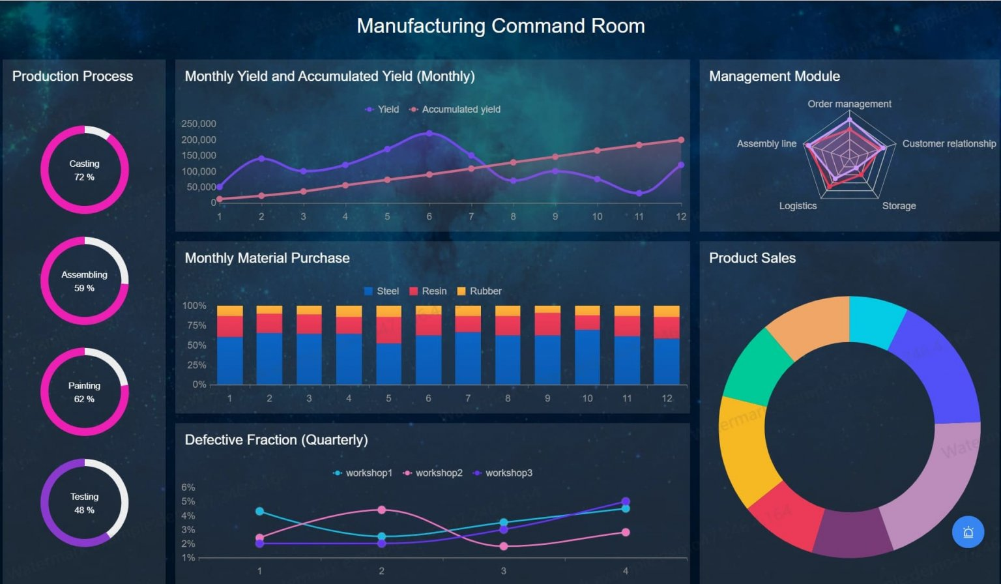
A BI system ensures timely and accurate delivery of information to the right individuals in the appropriate format, aiding both strategic and operational decision-making processes (FineReport, n.d., para. 3).
With user-friendly interfaces and tools such as drag-and-drop actions, it allows for precise and swift data analysis (FineReport, n.d., para. 4).
Beyond enhancing decision-making, BI systems play a critical role in optimizing business operations by identifying trends, increasing profitability, improving productivity, and enhancing operational efficiency (Warehouse Logistics, n.d., para. 3).
Additionally, BI systems enable companies to stay ahead of competitors by identifying market trends and aligning strategies to future demands, offering a significant competitive advantage (Warehouse Logistics, n.d., para. 3; FineReport, n.d., para. 4).
Figure 4
Business intelligence system - Manufacturing Command Room
Note. From FineReport, 2024, para. 6.

Slide 6
Key components in generic Business Intelligence system
Data Sources:
Data sources are places where raw data is collected, such as databases, spreadsheets, APIs, and external vendors. These sources can be structured, like relational databases, or unstructured, like social media. They provide the necessary data for BI systems to analyze and generate insights (FastCapital, n.d., para. 1).
Data Integration:
Data integration is the process of combining data from different sources into a unified format for analysis. Tools like ETL (Extract, Transform, Load) ensure the data is clean, consistent, and accessible for decision-making. This integration helps create a complete view of business operations, ensuring that data from various sources is well-organized and reliable (FastCapital, n.d., para. 2).
Data Warehousing or Data Storage:
Data warehousing refers to storing cleansed, transformed, and aggregated data in a central repository, optimized for easy querying and reporting (Lloyd, 2011, p. 51). It can be stored in data warehouses like Amazon Redshift or Google BigQuery, which are commonly used for structured data (Lloyd, 2011, p. 52). Data storage methods also include data lakes, which store both structured and unstructured data, offering more flexibility compared to traditional data warehouses (FastCapital, n.d., para. 1).
ETL Tools:
ETL tools extract data from various sources, transform it into a common format, and load it into a data warehouse. The process includes three stages: extraction, transformation, and loading, each crucial for converting raw data into actionable insights. These tools vary in focus, with some specializing in different stages of the ETL process (Lloyd, 2011, p. 52).

Slide 7
Data Analytics (including OLAP and Predictive Modeling):
Data analytics involves techniques to analyze data and generate insights, including descriptive, predictive, and prescriptive analytics (FastCapital, n.d., para. 14). BI systems use OLAP cubes to explore data from different angles, helping users analyze trends and patterns. Predictive models, like regression and clustering, are used to forecast future trends, such as predicting claim fraud (Lloyd, 2011, p. 54).
Reporting and Dashboards (Data Visualization):
Reporting tools generate static or dynamic reports that summarize data, while dashboards provide interactive visualizations of key metrics, trends, and comparisons (FastCapital, n.d., para 4). Data visualization tools, like charts and graphs, make complex data more accessible and easier to understand, helping users monitor performance (Williams, 2017, para 16).
Security and Access Control:
BI systems require strong security to protect sensitive data. Role-based access ensures users only see relevant information, such as restricting financial data access based on user roles (FastCapital, n.d., para 7).
BI Tools and Applications:
BI tools are software applications used for analyzing and visualizing data. Popular examples include Oracle Business Intelligence, SAS Business Intelligence, and other BI and analytics tools (FastCapital, n.d., para 7).
Data Mining:
Data mining finds patterns, relationships, and rules in data to predict outcomes or describe situations. Common techniques include classification, prediction, and market basket analysis, helping in decision-making by uncovering valuable insights (Lloyd, 2011, p. 55).

Slide 8
Key features of data warehouse
Subject-Oriented:
A data warehouse focuses on specific business areas like sales, finance, or customer information, allowing for targeted analysis and better decision-making rather than emphasizing daily operations. It eliminates unnecessary operational data, making the analysis more precise and effective (Astera, 2024, para. 5; Sprinkle, 2024, para. 2; GeeksForGeeks, 2023, para. 3; Intellipaat, 2019, 00:03:44).
Integrated:
It combines data from various sources, such as relational databases, flat files, and transactional systems, into a unified and consistent format with standardized naming conventions, codes, and structures, ensuring reliability for analysis. This integration allows businesses to maintain data consistency across all departments (Astera, 2024, para. 5; Sprinkle, 2024, para. 3; GeeksForGeeks, 2023, para. 4; Intellipaat, 2019, 00:03:44).
Time-Variant:
Data is stored with a time dimension, enabling historical analysis and trend identification over specific time periods. This feature allows organizations to forecast trends by comparing data from different time frames (Astera, 2024, para. 5; Sprinkle, 2024, para. 4; GeeksForGeeks, 2023, para. 5; Intellipaat, 2019, 00:03:44).
Non-Volatile:
Once added to the data warehouse, data is not deleted or updated, preserving historical information for stable and reliable long-term analysis. This ensures that even older data is available for retrospective evaluations (Astera, 2024, para. 5; Sprinkle, 2024, para. 5; GeeksForGeeks, 2023, para. 6; Intellipaat, 2019, 00:03:44).
Centralized Repository:
A data warehouse acts as a single source of truth, storing data from various sources in one place to simplify access, management, and analysis. It improves collaboration across departments by ensuring everyone uses the same data (Sprinkle, 2024, para. 6).
Read-Optimized:
Designed for fast querying and analysis, the data warehouse uses indexing and aggregations to support efficient reporting and business intelligence. This design reduces the time needed to generate complex reports (GeeksForGeeks, 2023, para. 9).

Slide 9
Summary Data:
Summarized and aggregated data is stored to enable quicker analysis and reporting, reducing the need for processing raw data repeatedly. This helps in saving storage space and improving query performance (GeeksForGeeks, 2023, para. 10).
Schema-on-Write:
Data is transformed and structured according to a predefined schema before loading, ensuring consistency and readiness for analysis. This approach makes the data warehouse ready for immediate querying once the data is loaded (GeeksForGeeks, 2023, para. 12).
Query-Driven:
It supports ad-hoc queries and reporting, allowing business users to access the data warehouse directly without requiring technical expertise. This flexibility enhances the decision-making process by enabling quick insights (GeeksForGeeks, 2023, para. 13).
Enterprise Data Warehouse (EDW):
EDW serves as a large-scale centralized system that ensures data quality, handles user demands, supports large data volumes, and enhances business intelligence capabilities. It also enables merging data for a unified data model and supports advanced analytics (Sprinkle, 2024, para. 7).
Historical Data:
The warehouse stores vast amounts of historical data, making it possible to analyze long-term trends, patterns, and performance metrics over extended periods. This aids in identifying significant changes or progress over time (GeeksForGeeks, 2023, para. 11).

Slide 10
How we measure success in implementing a Business Intelligence solution?
User satisfaction:
User satisfaction is a key measure of BI system success, focusing on how well the system addresses user needs. The evaluation process includes assessing whether the system provides the specific information that users require and if that information is accurate. Another important aspect is the format of the reports; users need to feel that the information is presented in a way that is both useful and easy to understand. Additionally, the system's ease of use plays a critical role, as users must find it intuitive and accessible. Timeliness is also crucial—users need to receive the information they need without unnecessary delays. For example, users are asked if the system is user-friendly, if the reports are clear, and whether the necessary information is provided on time (Dedić & Stanier, 2017, p. 04). By evaluating these factors, businesses can gain insight into whether their BI system truly meets user requirements and expectations.
Technical functionality:
Technical functionality focuses on assessing the system's operational performance and how well it supports various business processes. Key elements in this category include measuring the system’s response time for generating reports and the execution time for running queries. Another important aspect is how the system performs when re-executing reports with different parameters, such as changes in language, currency, or units. Technical functionality also considers memory usage and CPU consumption during report generation and query execution, which are essential for understanding the system's efficiency. Scalability is another critical factor—organizations must evaluate whether the system can handle increasing amounts of data and users over time. Additionally, the system’s flexibility and extensibility are important, as they determine whether the system can be easily adapted to meet evolving business needs (Dedić & Stanier, 2017, p. 08). By measuring these technical aspects, organizations can ensure their BI system is capable of supporting long-term growth and operational demands.

Slide 11
Comparison of data before and after implementing changes:
To effectively measure the success of changes made to the BI system, it is essential to compare the data from two stages: before the changes are implemented and after they are in place. This comparison provides valuable insights into whether the modifications have led to improvements in system performance and user satisfaction. By analyzing the results from both the existing BI environment and the modified system, organizations can assess whether the changes have had a positive impact. For example, they can evaluate if the system’s response times have improved, if user satisfaction has increased, or if technical issues have been addressed. This before-and-after comparison serves as a powerful tool for understanding the effectiveness of the changes (Dedić & Stanier, 2017, p. 08).
Evaluation tool for measuring BI system effectiveness:
To streamline the process of measuring the effectiveness of changes to the BI system, an evaluation tool has been developed that combines both user satisfaction and technical functionality metrics. This tool is designed to be flexible and customizable, allowing organizations to adapt it to their specific needs. It enables businesses to assess the effectiveness of their BI system in the reporting aspect and can also be used to benchmark various BI solutions. This means that organizations can compare different BI systems to identify the most suitable one for their needs. The evaluation tool is useful not only for assessing changes to BI reporting systems but also for selecting and implementing BI software. The tool could also be extended in the future to include other areas such as data warehousing or data modeling (point 5). By utilizing this tool, organizations can make more informed decisions and ensure that their BI solutions are meeting both user and technical requirements. (Dedić & Stanier, 2017, p. 11).

Slide 12
REFERENCES
Astera. (2024, September 03). What is Data Warehousing? Concepts, Features, and Examples.
https://www.astera.com/type/blog/what-is-data-warehousing/#:~:text=Enlisting%20the%20Features,seen%20in%20the%20data%20warehouse.
Big Data Analytics News. (2017, December 29). Top 10 Free And Open Source Business Intelligence Software!
https://bigdataanalyticsnews.com/top-free-open-source-business-intelligence-software/
CIO. (2023, January 20). What is business intelligence? Transforming data into business insights.
https://www.cio.com/article/272364/business-intelligence-definition-and-solutions.html#:~:text=Business%20intelligence%20(BI)%20is%20a,Credit%3A%20Milad%20Fakurian%20%2F%20Unsplash
Dedić, N., & Stanier, C. (n.d.). Measuring the success of changes to existing BI. Conestoga College Desire to Learn Student Portal.
https://conestoga.desire2learn.com/d2l/home
FasterCapital. (n.d.). Key Components Of Business Intelligence Systems.
https://fastercapital.com/topics/key-components-of-business-intelligence-systems.html
FineReport. (2024, April 09). Business Intelligence System: Definition, Application & Practice of BI Systems.
https://www.finereport.com/en/bi-tools/business-intelligence-system.html
GeeksForGeeks. (2023, February 03). Characteristics and Functions of Data warehouse.
https://www.geeksforgeeks.org/characteristics-and-functions-of-data-warehouse/
Google Cloud. (n.d.). What is Business Intelligence (BI)?
https://cloud.google.com/learn/what-is-business-intelligence
IBM. (n.d.). What is business intelligence (BI)?
https://www.ibm.com/think/topics/business-intelligence
Intellipaat. (2019). What is Data Warehouse - Data Warehouse Tutorial - Intellipaat [Video]. YouTube.
https://www.youtube.com/watch?v=Dz0kKer5ApE
mTab. (n.d.). Advanced Data Analysis Methods You Need to Know.
https://mtab.com/blog/advanced-data-analysis-methods-you-need-to-know
Lloyd, J. (2011). Identifying key components of business intelligence systems and their role in managerial decision-making (Master's thesis). University of Oregon, Applied Information Management Program.
https://core.ac.uk/download/36686081.pdf
Olavsrud, T., & Fruhlinger, J. (2023, January 20). What is business intelligence? Transforming data into business insights. CIO
https://www.cio.com/article/272364/business-intelligence-definition-and-solutions.html
Oracle. (n.d.). What is Business Intelligence (BI)?
https://www.oracle.com/ca-en/what-is-business-intelligence/
Sprinkle. (2024, July 22). Characteristics of Data Warehouse: Understanding the Core Features.
https://www.sprinkledata.com/blogs/characteristics-of-data-warehouse-understanding-the-core-features
Sprinkle. (2024, August 19). Understanding Business Intelligence Architecture: A Comprehensive Guide.
https://tinyurl.com/sprinkledata
Warehouse Logistics. (n.d.). Definition Business Intelligence System.
https://www.warehouse-logistics.com/en/definition-bi.html
Williams, J. (2017, January 16). Essential Components of a Business Intelligence System.
https://www.promptcloud.com/blog/essential-components-of-a-business-intelligence-system/

